Slide 1
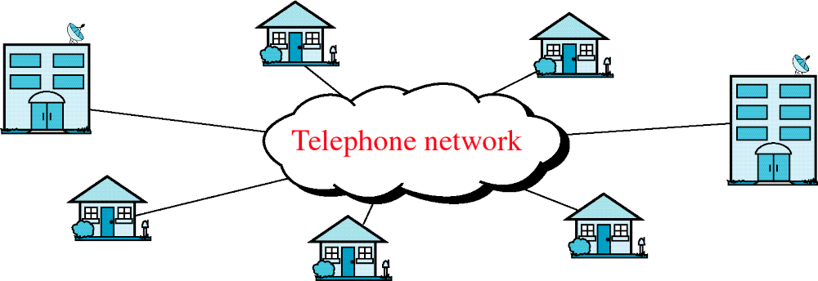
Figure 8-17
Telephone Network
WCB/McGraw-Hill
© The McGraw-Hill Companies, Inc., 1998

Slide 2
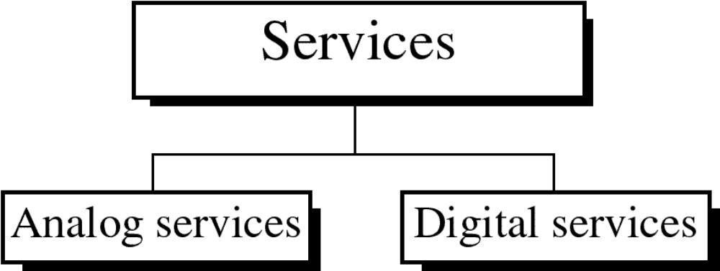
Figure 8-18
WCB/McGraw-Hill
© The McGraw-Hill Companies, Inc., 1998

Slide 3
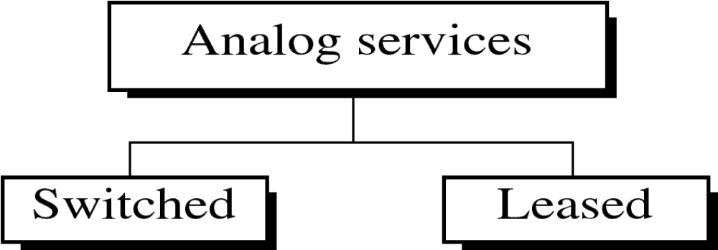
Figure 8-19
WCB/McGraw-Hill
© The McGraw-Hill Companies, Inc., 1998

Slide 4
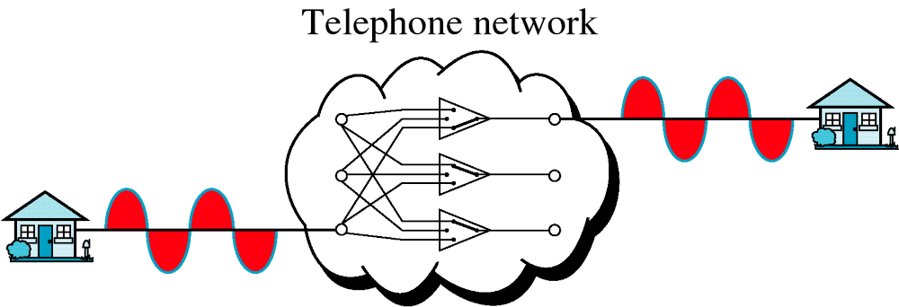
Figure 8-20
Analog Switched Service
WCB/McGraw-Hill
© The McGraw-Hill Companies, Inc., 1998

Slide 5
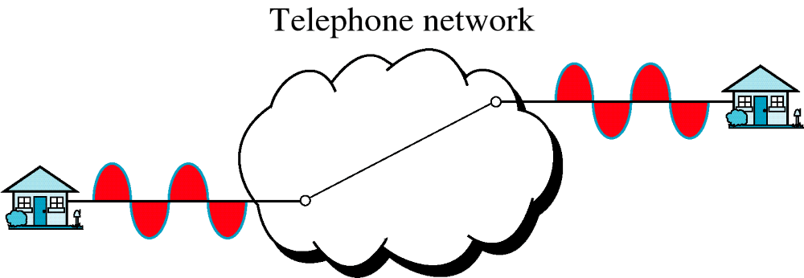
Figure 8-21
Analog Leased Service
WCB/McGraw-Hill
© The McGraw-Hill Companies, Inc., 1998

Slide 6
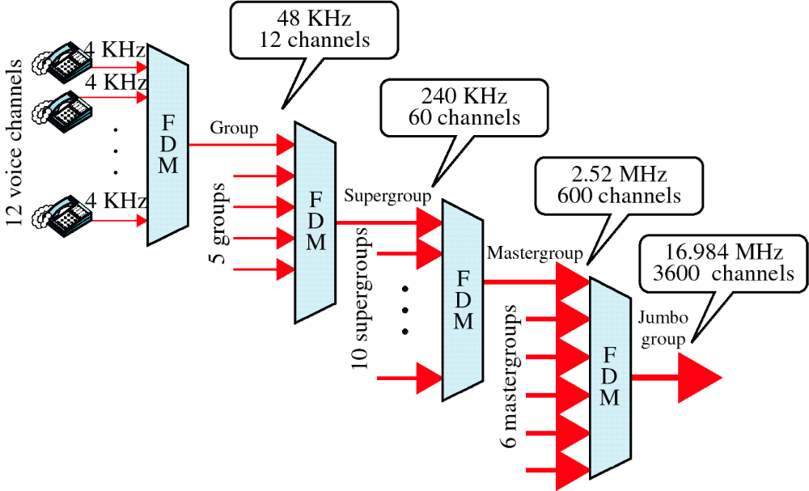
Figure 8-22
Analog Hierarchy
WCB/McGraw-Hill
© The McGraw-Hill Companies, Inc., 1998

Slide 7
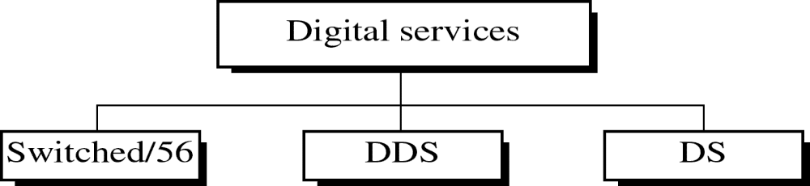
Figure 8-23
WCB/McGraw-Hill
© The McGraw-Hill Companies, Inc., 1998

Slide 8
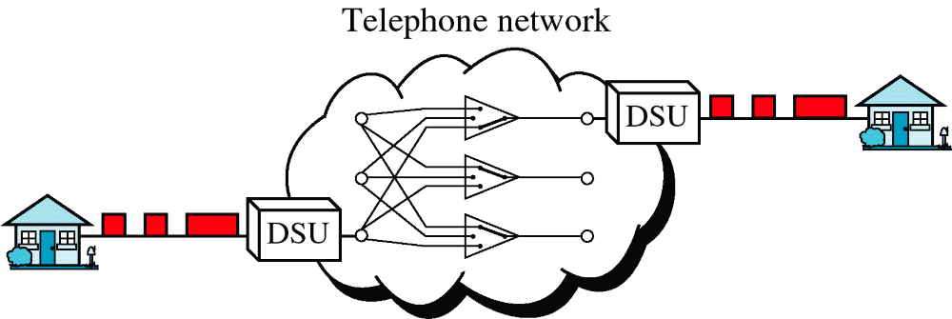
Figure 8-24
Switched/56 Service
WCB/McGraw-Hill
© The McGraw-Hill Companies, Inc., 1998

Slide 9
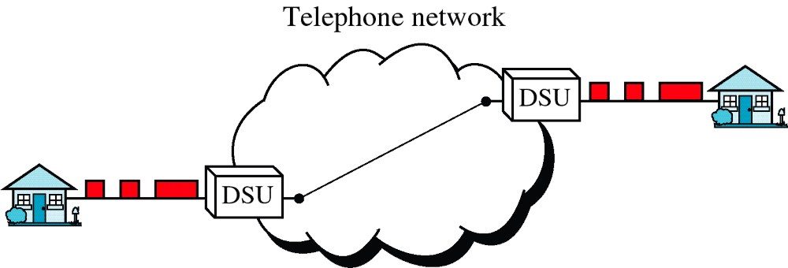
Figure 8-25
DDS
WCB/McGraw-Hill
© The McGraw-Hill Companies, Inc., 1998

Slide 10
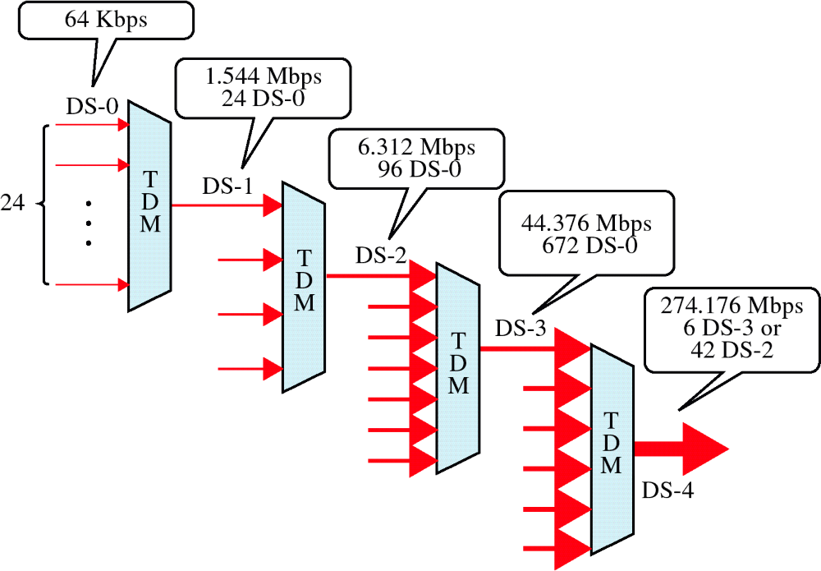
Figure 8-26
DS Hierarchy
WCB/McGraw-Hill
© The McGraw-Hill Companies, Inc., 1998

Slide 11
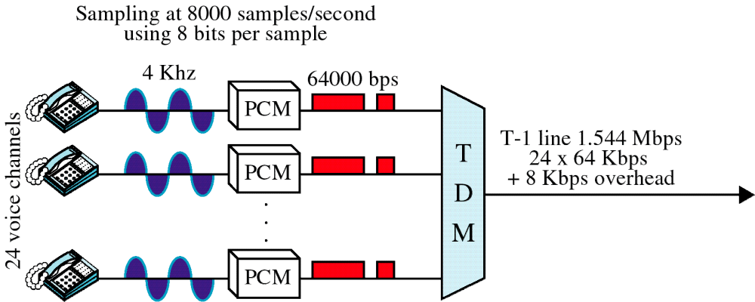
Figure 8-27
T-1 Line
WCB/McGraw-Hill
© The McGraw-Hill Companies, Inc., 1998

Slide 12
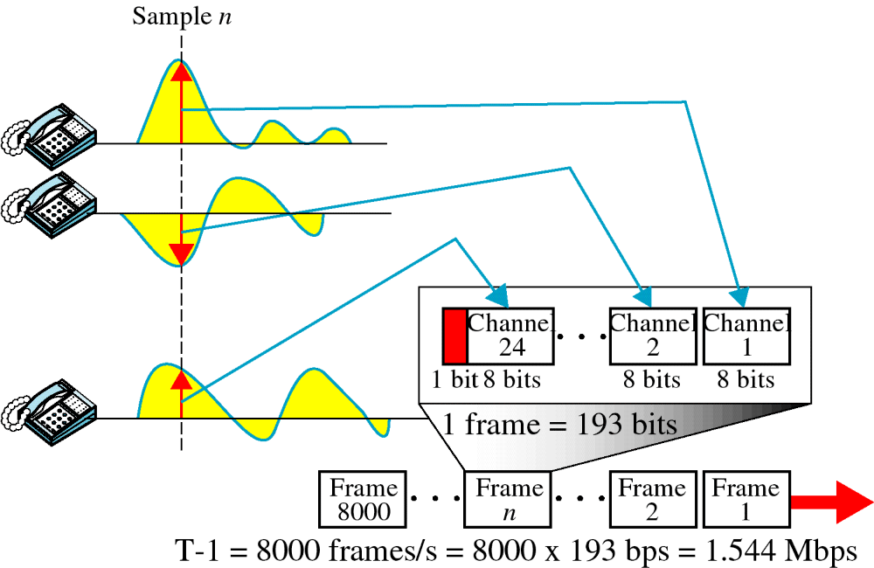
Figure 8-28
T-1 Frame
WCB/McGraw-Hill
© The McGraw-Hill Companies, Inc., 1998

Slide 13
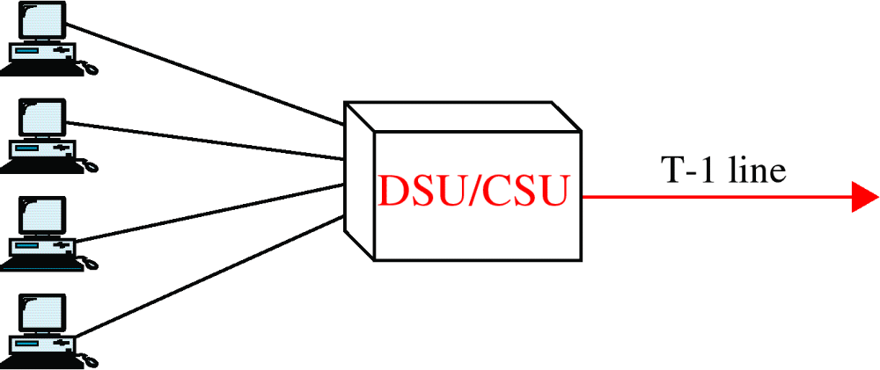
Figure 8-29
Fractional T-1 Line
WCB/McGraw-Hill
© The McGraw-Hill Companies, Inc., 1998

